Slide 1
2023 general assembly session recap
April 2023

Slide 2
2023 SESSION AT A GLANCE
New Governor & Constitutional Officers
New State Agency Leadership
New Legislative Budget Authority
New Committee Chairs & Members

Slide 3
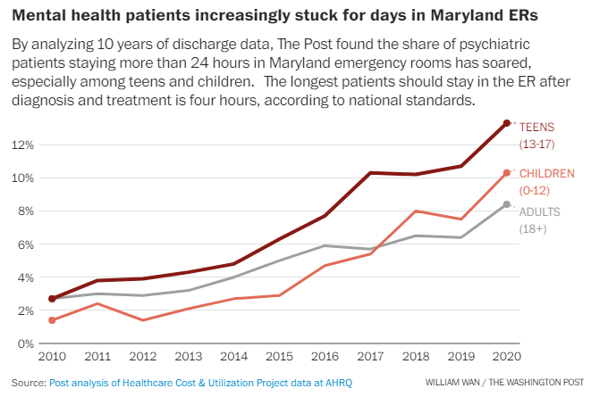
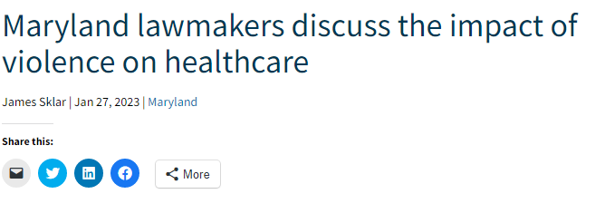
2023 health care Legislative climate

Slide 4
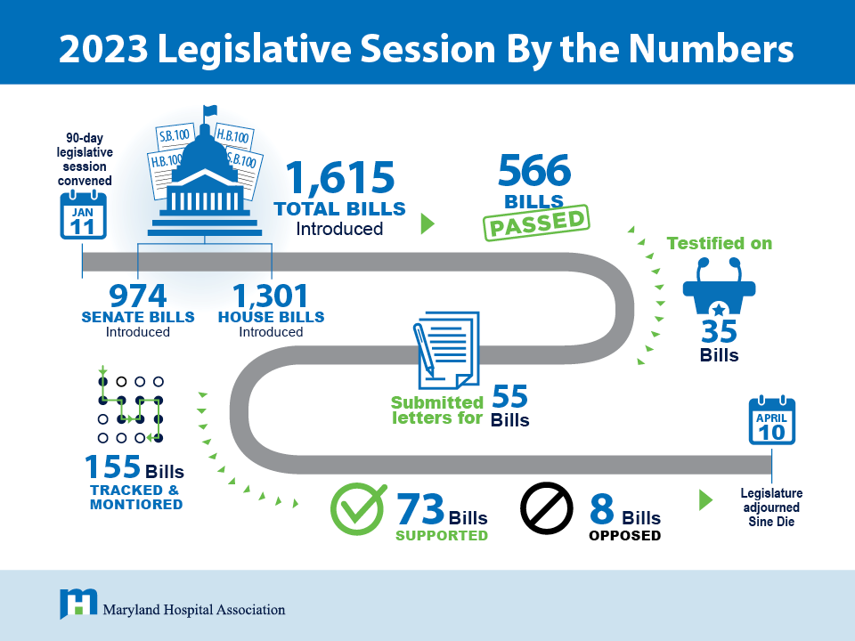
*Does not include crossfiles

Slide 5
Outcomes on hospital field priorities & other key issues

Slide 6
Mha 2023 legislative agenda
Strengthen Maryland’s Hospital Workforce
Ensure Access to Care
Improve Maryland’s Medical Liability Climate

Slide 7
Significant state Investments in health care
Additional MHA Priorities
Physician and Physician Assistant Loan Repayment Program: $1.4 Million
Up from $400,000 in FY 2020 before MHA promoted
Generates $1 million federal match
Nurse Loan Repayment Program: $3 Million
Capital Budget: About $9.9 Million
Secured funds for MHA’s capital bond program for 9 projects
More out-year funding: $9 million (FY 2026), $10 million (FY 2027, FY 2028)
Program established during 2022 session through legislation supported by MHA
Launched in March 2023
$50 Million Medicaid Deficit Assessment Reduction
One-time reduction to temper mid-year rate reduction impact on hospitals

Slide 8
All Workforce Priorities Advanced
Maryland Board of Nursing reform
Transfers Board infrastructure oversight to Secretary of Health for 2 years
Requires collaboration with state agencies to address staffing vacancies and outdated IT
Allows nurse graduates 2 attempts to pass the national licensure exam while maintaining nurse graduate status
Permits release of aggregate data to support workforce planning
Modernized state law for physician credentialing
Created pathway for internationally-educated nurses to receive an initial Maryland license by removing social security number requirement

Slide 9
access to care proposals passed
Telehealth
Passed MHA bill to extend reimbursement parity and allow audio-only telehealth for two years
Requires MHCC to conduct a final study on telehealth and provide recommendations on the permanent role of telehealth in Maryland's health care system
Behavioral Health
Helped advance comprehensive legislation to significantly improve Maryland's behavioral health system of care including:
Establishing the Commission on Behavioral Health Treatment and Access
Implementing a 500-person value-based purchasing pilot program to help individuals at risk of visiting emergency departments due to behavioral health crises

Slide 10
access to care proposals passed (cont.)
Partnered on package to expand access to health insurance coverage and enhance affordability:
Continue premium subsidies for young adults
Increase access to Medicaid through express lane enrollment
Require state agencies to explore health and dental care coverage options for undocumented immigrants

Slide 11
Fended off attempts to worsen liability environment
Blocked three problematic trial-attorney backed bills that aimed to:
X Expand definition of medical records to include audit trails, circumventing discovery as part of a legal proceeding
X Expand authority of Health Care Alternative Dispute Resolution Office
X Remove the cap on non-economic damages for personal injury and wrongful death cases
Defeated attempt to allow direct entry midwives to perform home birth after C-section
Partnered with clinical leaders to articulate significant safety risks for mom and baby
Fought against significant bipartisan support in the House and Senate
Will require interim work with the Maryland Direct Entry Midwifery Advisory Committee

Slide 12
Successful outcome on challenging issues
Defeated expansion of Maryland's False Health Claims Act
Blocked mandate regarding pediatric dental procedures, replaced with requirement for regional needs assessment
Worked with sponsor on hospital refund process to ensure administratively feasible and inclusion of key safeguards
Halted legislation mandating that medical marijuana use be allowed in hospitals, which conflicts with federal rules

Slide 13
Supported passage of other key bills
Support for Sexual Assault Survivors
Established requirements for implementing a statewide tracking system for sexual assault evidence kits
Ensured preservation of evidence collected by health care providers or self-collected
Supported annual state investment to supplement federal Victims of Crime Act funding
Step Therapy Protocols
Created exceptions for step therapy protocols
Limited payer review time for step therapy exception requests
Firearm Safety
Ensured the inclusion of hospitals as “sensitive locations” where firearms are not permitted to be carried
Advanced legislation to reduce youth suicide by enhancing safe gun storage requirements

Slide 14
New Hospital operations Requirements
Fair Wage Act of 2023
Accelerates implementation of Maryland’s $15 minimum wage for all employers to Jan. 1, 2024
Provisions tying future increases to inflation were removed
Paid Family Leave (Time to Care Act) Implementation
Establishes paid family and medical leave insurance program
Employer & employee contributions delayed to Oct. 1, 2024; program begins Jan. 1, 2026
50/50 match between eligible employers and employees
Mental Health Treatment Plans
Requires hospitals to establish policies to include family or other individuals in treatment planning process with patient consent including requesting a review of the treatment plan
Creates new appeals and grievance process for individuals and families of patients in state facilities and requires MDH to submit an annual report

Slide 15
HSCRC-related legislation
HB 420/SB 234: Health Services Cost Review Commission-Hospital Rates-All-Payer Model Contract
Requires HSCRC to set hospital rates in a manner consistent with the All-Payer Model Contract
Aligns statute with existing practice
SB 626: Health Services Cost Review Commission – Members -Appointment
Requires Senate confirmation for gubernatorial appointments to HSCRC

Slide 16
2023 INTERIM WORK

Slide 17
Interim work: MHA-led efforts to prepare for 2024 session
Staffing Ratios
Medical Marijuana in Hospitals
Respond to local effort and educate state policymakers and stakeholders in anticipation of bill introduction
Direct Entry Midwives
Identify opportunities to improve home-to-hospital transfer protocol, informed consent, data reporting and other bill provisions
Collaborate with advocates and other state associations on policy options
Collaborate to increase awareness of access to vaginal birth after C-section services in hospitals and promote best practices regarding repeat C-sections
Notes:
Transport – SB 295

Slide 18
Interim work: State Agency-led work
Pediatric Dental
Intensive effort with Maryland Department of Health and Maryland Health Care Commission to complete regional needs assessment on pediatric dental surgical procedures
Emergency Department Wait Times
Legislative requested stakeholder group to examine key drivers of wait times
High profile issue that will require continued engagement with dental association, relevant state agencies, and stakeholders
MHA improvement collaborative to share best practices on ED throughput
Access to Birthing Center Services
Participate in Maryland Department of Health stakeholder work group to develop recommendations for expanding access to birthing services in birthing centers
Notes:
TBD – keep as placeholder

Slide 19
Interim work: State Agency-led work
Geriatric Nursing Assistant (GNA) Certification
MDH-led work group to consider GNA designation removal and strategy for aligning certified nursing assistant requirements across health care settings
Commission to Study Trauma Center Funding
Establishes the Commission to Study Trauma Center Funding in Maryland to study adequacy of funding across the State for operating, capital, and workforce costs
MHA focus on preserving an acute care CNA pathway
Telehealth Study
MHCC to study and make recommendations regarding delivery of health care services through telehealth, including payment parity for delivery of health care services through audio-visual and audio-only telehealth technologies
Notes:
TBD – keep as placeholder

Slide 20
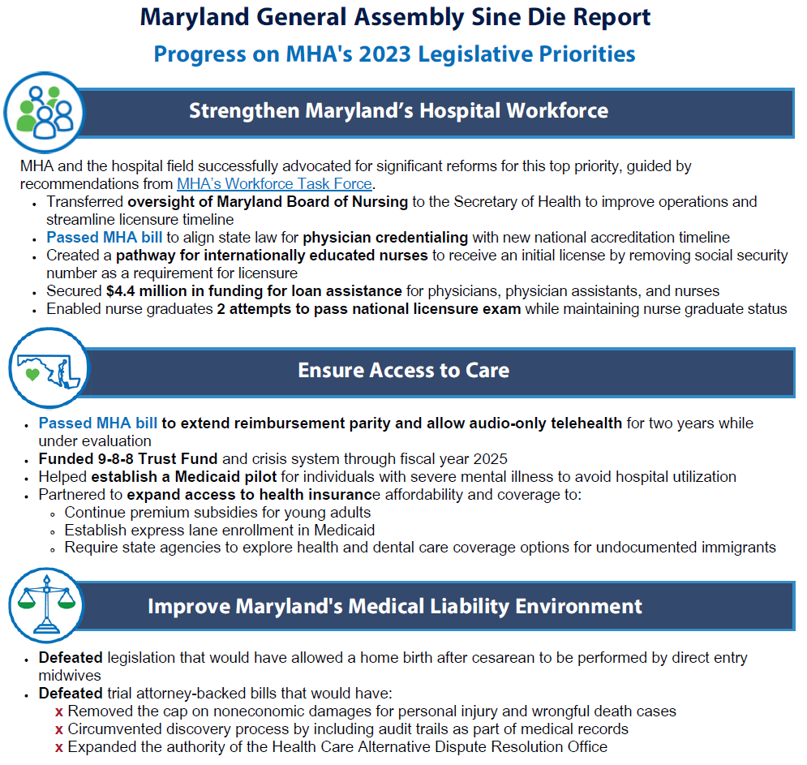
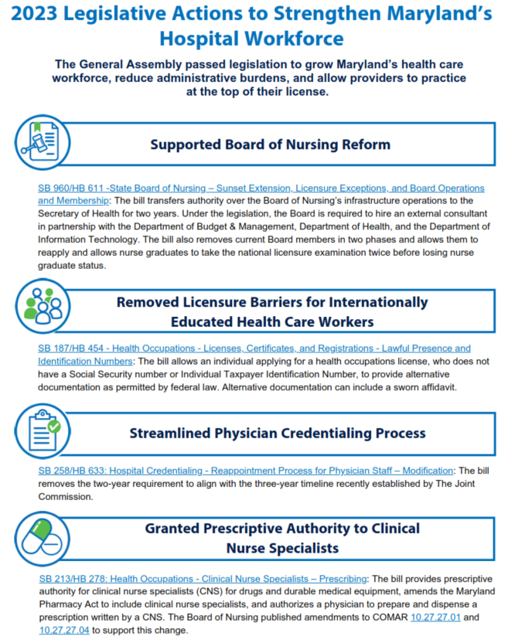
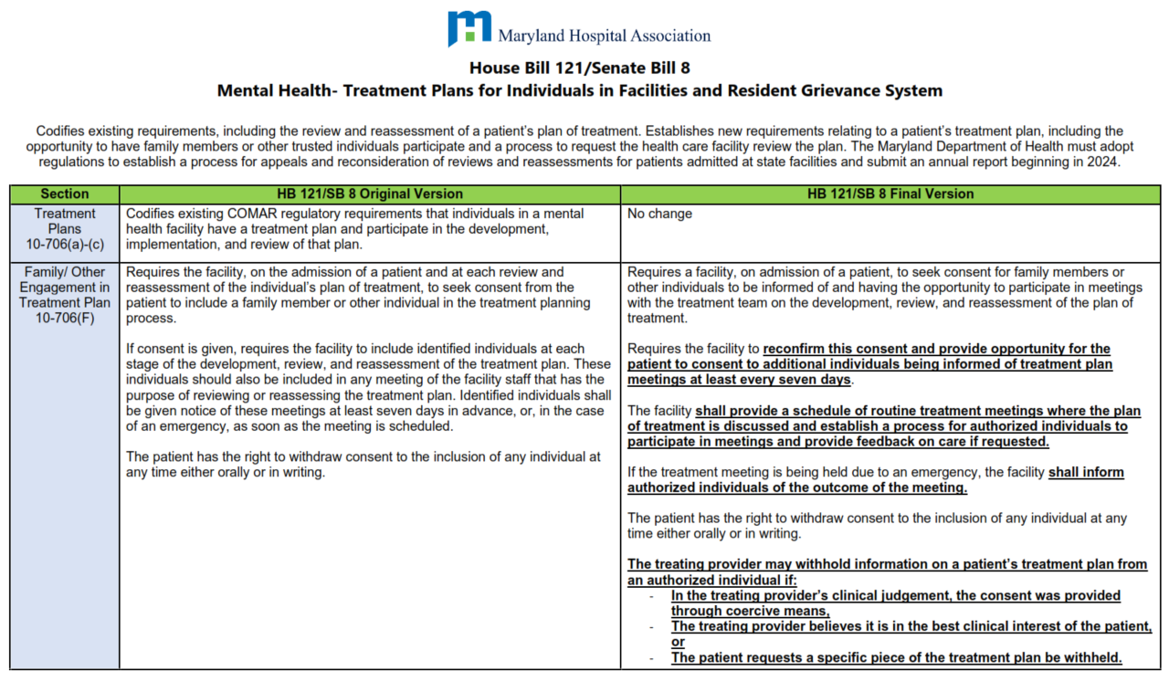
more MHA member resources
Sine Die Report
Post-Session Action Map
Bill Summary: Side-by-Side
Bill Summary: Key Takeaways
Find Resources at: mhaonline.org/advocacy/legislative/state

