Slide 1
2024 general assembly session recap
April 2024

Slide 2
2024 SESSION AT A GLANCE
Administration Hitting Their Stride
Influential Advocacy Groups
Anticipated Budget Shortfall
Changing Committee Assignments

Slide 3
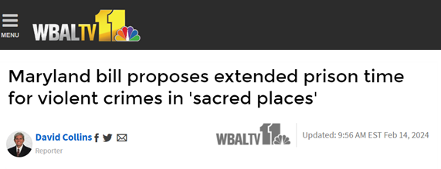
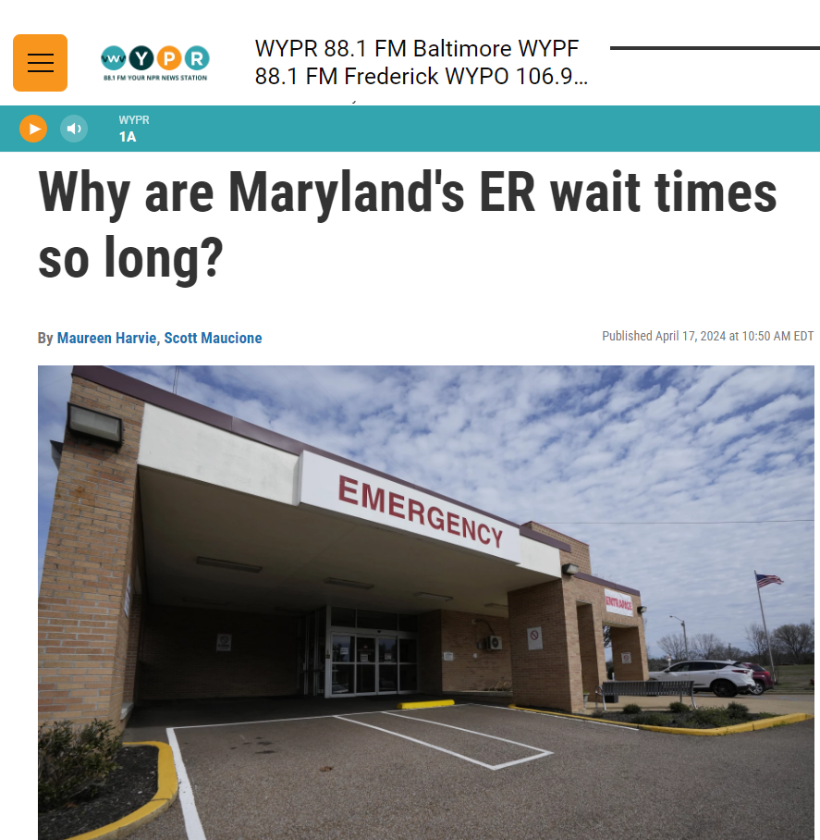
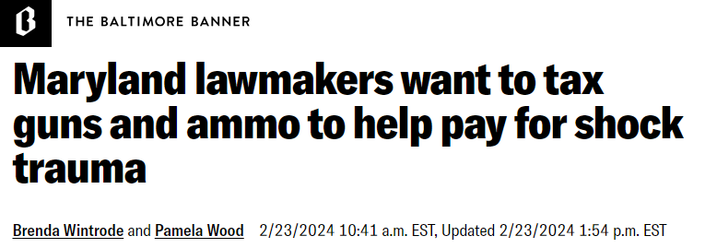
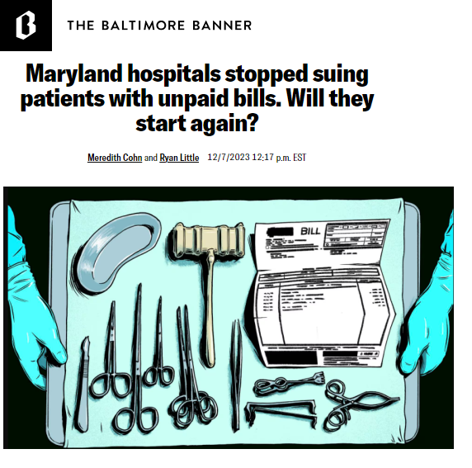
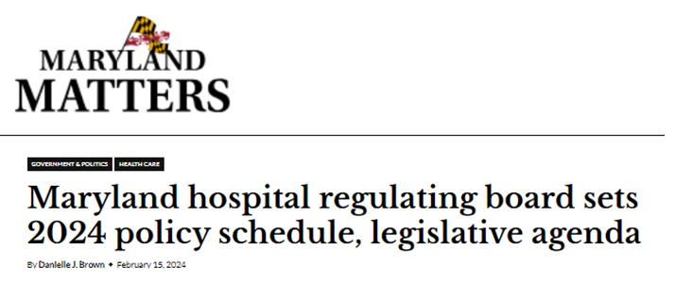
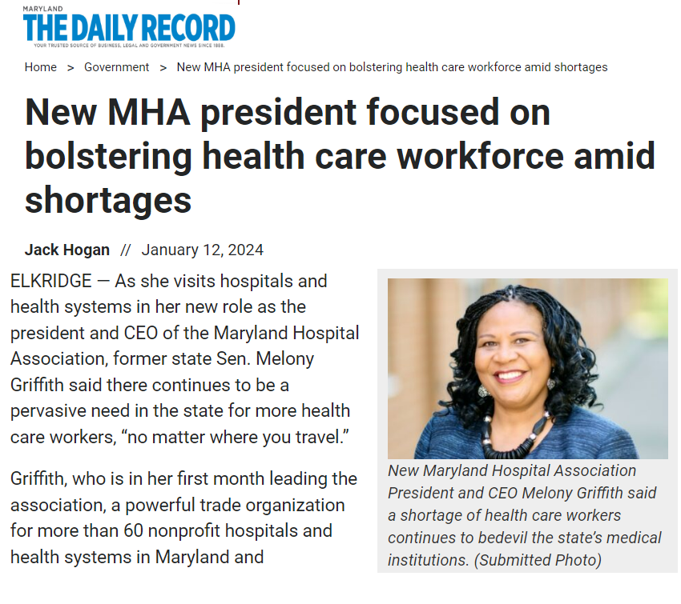
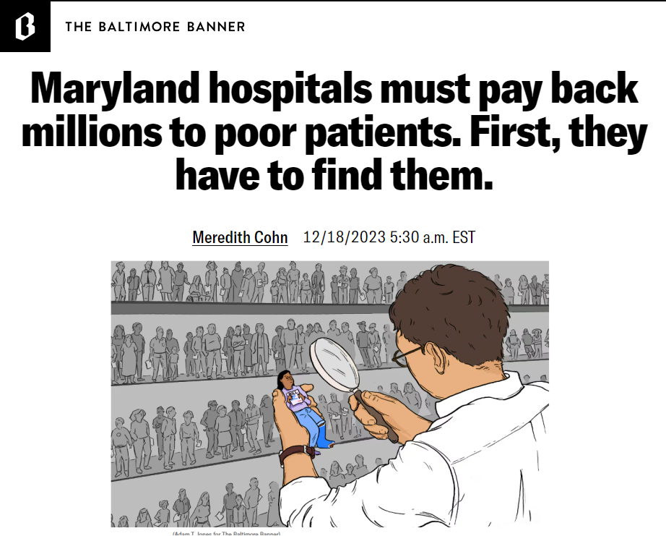
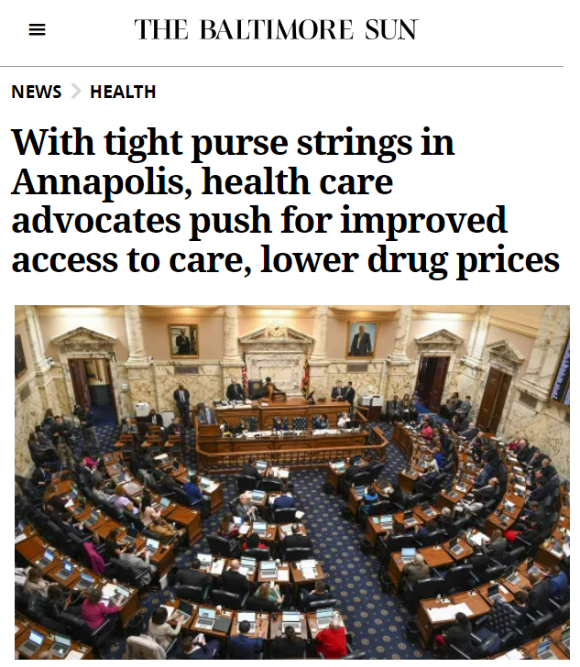
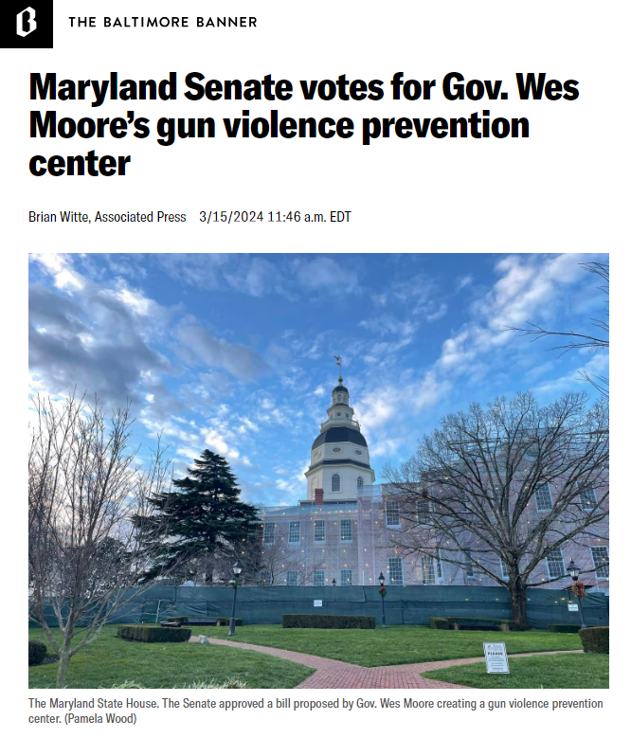
2024 health care Legislative climate

Slide 4
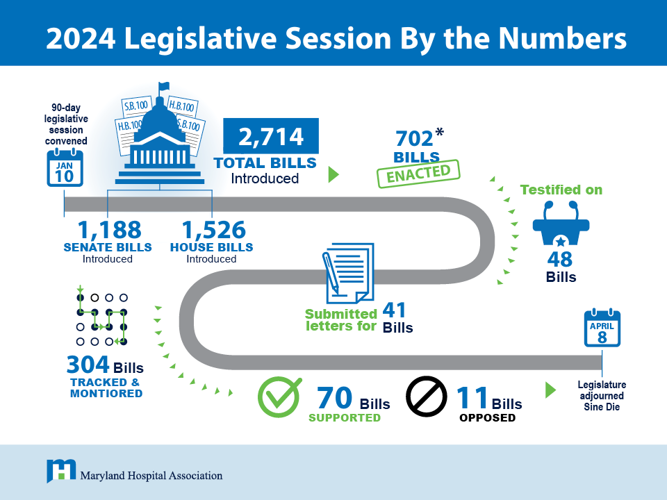
*Bills enacted as of May 10, 2024

Slide 5
MHA 2024 legislative agenda
Ensure access to care and improve hospital throughput for all Marylanders
Strengthen Maryland’s health care and hospital workforce
Protect Maryland’s liability climate and maintain the state as a viable place to practice medicine

Slide 6
Outcomes on hospital field priorities & other key issues

Slide 7
Significant state Investments in health care
Additional MHA Priorities
Passed legislation to codify the Hospital Bond Program in statute and increase future program funding to $20 million
$5M investment for pediatric cancer research
$1M investment in public workplace violence awareness campaign
Physician and Physician Assistant Loan Repayment Program: $3 Million
Up from $400,000 in FY 2020
Generates $1 million federal match
Nurse Loan Repayment Program: $3 Million
Capital Budget:
$6.8 Million
Secured funds for 6 projects across the state, vast majority impacting behavioral health care access for youth
Established during 2022 session through legislation supported by MHA
Launched in March 2023

Slide 8
Additional Budget Highlights
Investment in Trauma Response Care
$105M of new revenue for EMS services beginning FY 25
Provider Rate Increase
$14.4B for Medicaid with 3% rate increase for providers including development disability, behavioral health, nursing homes, and community-based providers
Climate Initiative
$90M Climate Pollution Reduction Effort includes $50M in grants to electrify hospital, schools, and other community buildings
Investment in Gun Violence Prevention
$8M for gun violence prevention and intervention programs
$41M for Shock Trauma
$18M to expand reimbursements from Maryland Trauma Services Fund

Slide 9
Workforce Priorities Advanced
Limited Scope X-ray Machine Operator Licensure Exception
Health care workers with six months of clinical experience can conduct limited x-rays of the chest, spine and extremities in physician offices and urgent care centers under supervision of a physician or radiologic technologist
Requirements include: clinical and didactic training, passage of a Maryland Board of Physicians approved exam and required registration with the Board
Registered Cardiovascular Invasive Specialists (RCIS)
Extension of licensure exception to perform duties delegated by a physician during fluoroscopy

Slide 10
Workforce Priorities Advanced
Certified Nursing Assistant (CNA)/Geriatric Nursing Assistants
Removed CNA certification requirement for nursing students performing nursing assistant tasks outside of school sanctioned activities (Beginning Oct. 1, 2025)
Maryland Board of Nursing will promulgate regulations to identify the portion of the nursing school curriculum that a student will need to complete to qualify
Maryland Pathway to Nursing Pilot Program
Establishes an advisory committee to guide implementation
Requires two geographically diverse pilot sites
Legislation creates phased in approach to create a single CNA designation that can be used across health care settings including skilled nursing facilities
Provide supports for basic living expenses for licensed practical nursing (LPN) students

Slide 11
Workforce Priorities Advanced
Security Guard Certification and Training
Delayed implementation date of legislation passed in 2023 to Jan. 1, 2025 to allow time for hospital security guards to be certified and complete required 12 hours of training
Created alternative aggregate 7 day reporting of code greens and code purples instead of individual use of force reporting by incident
Physician Assistants (PAs)
Removed the requirement for the Board to approve advanced duties in exempt facilities including hospitals if certain conditions are met (i.e. supervising physician has been credentialed by the exempt facility and the advanced duty is reviewed and approved by the exempt facility)
Defeated legislation to add requirements to surgical technicians’ training
Modernized PA practice by allowing for collaboration agreements instead of delegation agreements
MHA will convene a member group in the interim to discuss the new reporting requirement
Adds PAs to the medical malpractice statute

Slide 12
Non-compete agreements
Bill as introduced would have banned all non-compete agreements for health care providers.
Amended bill requires a study to examine impact of private equity firms on Maryland’s health care market and the State’s ability to meet the goals of the Total Cost of Care Model. (Jan. 1, 2025)
Limit on non-compete agreements applies to contracts executed on or after July 1, 2025. At that time, non-compete agreements will be limited to employees earning more than $350K per year, geographically restricted to ten miles, and will be limited to one year.

Slide 13
Staffing ratios
“Safe Staffing Act of 2024” - HB 1194 / SB 1020
Supported by SEIU 1199
Passed the House, did not come up for a vote in Senate Finance
As introduced:
Required hospitals to establish and maintain a clinical committee that develops staffing plans​
Staffing plans are for each patient care unit and work shift and are required to be posted by unit including the daily staffing for each unit​
Hospitals must submit staffing plan to HSCRC ​
As amended (House bill only):
Changed reporting requirements to HSCRC by requiring hospitals to submit staffing plans upon request
Notes:
Bill Hearings
House Health Government Operations Committee amended and voted the bill out of the Committee favorably
Senate Finance Committee did not adopt House amendments. The Committee did not vote the bill
Next Steps
Prepare for anticipated re-introduction of a staffing ratios bill
Continued education for legislators​
Strategize and partner with MONL, CNOs, government affairs leads, and consultants to oppose potential future legislation

Slide 14
Emergency Department Throughput
Legislation passed establishing the Maryland Emergency Department Wait Time Reduction Commission
The Commission will include MDH, MIEMMS, MHA, hospital administrators and clinical experts, policy advocates and behavioral health professionals.
The Commission will develop recommendations, not create or implement policy.
The Commission will have an expanded focus to analyze how Maryland’s entire health care system impacts hospital throughput.
Commission will end on June 30, 2027.

Slide 15
access to care proposals passed
Access To Care Act
Allows qualified Maryland residents, who otherwise do not qualify for federal or state insurance, to purchase insurance through the Maryland Health Benefit Exchange
Assisted Outpatient Treatment (Governor Moore Priority)
Requires MDH to establish an assisted outpatient treatment program in counties that do not opt for a program
9-8-8 Trust Fund Fees
Establishes a permanent funding source for the 988 Trust Fund to sustain and strengthen 988 mental health helpline services in Maryland.

Slide 16
access to care proposals passed
Prior Authorization for Prescription Drugs
New reporting requirements for insurers including the number of adverse decisions overturned after a reconsideration request
Preserve Access to 340B Drugs
Prohibits pharmaceutical manufacturers from placing restrictions on 340B contract pharmacies

Slide 17
Fended off attempts to worsen liability environment
Blocked problematic trial-attorney backed bill that aimed to:
X Remove the cap on non-economic damages for personal injury and wrongful death cases
Defeated attempt to allow direct entry midwives to perform home birth after C-section
Partnered with clinical leaders to articulate significant safety risks for mom and baby
Fought against significant bipartisan support in the House and Senate

Slide 18
Successful outcome on challenging issues
Defeated SEIU bill mandating staffing ratios by unit and requiring staffing committees
Defeated legislation that would have allowed direct entry midwives to attend vaginal births after cesarean section
Preserved ability to consider significant monetary assets when determining eligibility for charity care
Halted legislation expanding notice for hospitals outpatient facility fees
Blocked PhRMA effort to exclude hospitals from protections on contract pharmacy arrangements for 340B drugs
Defeated plaintiff attorneys bill to eliminate caps on noneconomic damages in wrongful death actions

Slide 19
Supported passage of other key bills
Support for Sexual Assault Survivors
Ensured the reimbursement of sexual assault forensic examinations conducted through peer to peer telehealth.
Firearm Safety
Established the Center for Firearm Violence Prevention in the Maryland Department of Health to reduce firearm violence
Requiring the Maryland Sexual Assault Evidence Kit Policy and Funding Committee to conduct a study and report findings on the telehealth program

Slide 20
Maternal and Child Health Legislation
Advanced the Maternal Health Act that focuses on assessing risk factors and causes of severe maternal morbidity, and improving referrals for high-risk birthing parents
Requires hospitals to participate in severe maternal morbidity reviews by Oct. 1, 2024.
The Maryland Department of Health must establish a process by which providers can submit referral forms electronically. MDH committed to include MHA and others in a working group to streamline the form completion and submission process.
Supported legislation requiring hospitals to provide information on safe sleep practices to parents of newborns
Hospitals must develop a process for providing each parent or legal guardian with oral and written educational resources on safe sleep, having the parent or legal guardian confirm receipt of the resources, and documenting this interaction.

Slide 21
New Hospital operations Requirements
GIFT Act
Financial Assistance Eligibility - Modifications
Updates financial assistance eligibility requirements to remove consideration of patient’s zip code
Requires healthcare providers to submit a report to the Secretary of Health on pregnant women testing positive for HIV and on the birth of an infant whose mother has tested positive for HIV.
Modifies amount of monetary assets that may be considered

Slide 22
2024 INTERIM WORK

Slide 23
Interim work: Work Groups & Studies
Foster Youth Hospital Overstays
Department of Human Services (DHS) to report on children and youth experiencing stays in emergency rooms or inpatient hospital settings for longer than is medically necessary.
Sexual Assault Exam Telehealth Feasibility Study & Pilot
Maryland Sexual Assault Evidence Kit Policy & Funding Committee to convene workgroup, which will include MHA staff and hospital representatives, to study the framework, development, implementation, and process to create a TeleSAFE Pilot Program.
Noncompete – Private Equity
Maryland Health Care Commission (MHCC) is tasked with studying the effect of private equity firms on Maryland’s health care market, including impacts on health disparities, access to care, and workforce shortages. Hospital representatives will be consulted as relevant stakeholders.

Slide 24
Interim work: Work Groups & Studies
Reimbursement for Maternal Fetal Medicine
MDH, MHCC, and HSCRC to study reimbursement rates under the Medicaid program for services provided by maternal fetal medicine specialists.
Maternal Health
MDH to convene a workgroup, which will include MHA representatives, to digitize forms required by the legislation for submission from hospitals to local health departments.
MDH, MHCC, HSCRC, and Maryland Society of Anesthesiologists to study barriers in recruitment and retention of anesthesiologists, as well as provide recommendations to eliminate identified barriers.
Recruitment & Retention of Anesthesiologists

Slide 25
Interim work: Work Groups & Studies
Guardianship
Diane Hoffmann from the University of Maryland Carey School of Law will convene a work group, which will include MHA staff and hospital representatives, exploring solutions for guardianship of patients with hospital overstays.
Outpatient Facility Fees
Health Services Cost Review Commission (HSCRC) with the Maryland Department of Health (MDH) and the Health Education Advocacy Unit of the Attorney General’s Office (HEAU) to convene a work group to advise on expanding application of facility fee notice to all outpatient services and the impact of such expansion on patients with different health insurance coverage. Hospital representatives will be included.
Cybersecurity Workgroup and Study
At the request of Senator Hester-Fry and Del Kerr, MHA will work with the Maryland Cybersecurity Council to convene a work group to discuss minimum cybersecurity standards, third party assessments, reporting, designating Chief Information Security Officers and legislation in other states.

Slide 26
Interim work: MHA-led efforts
Staffing Ratios
Educate state policymakers and stakeholders in anticipation of bill re-introduction
Protected Reproductive Health Information
Collaborate with MHCC and electronic health record vendors to implement protections for reproductive health information with minimal administrative burdens
Strategize and partner with MONL, CNOs, government affairs leads, and consultants to oppose potential future legislation

Slide 27
Interim work: State Agency-led work
Pediatric Dental
Maryland Department of Health to publish final report based on MHA, MHCC, and MDH surveys on dental OR capacity
Emergency Department Wait Times
Ongoing MHA improvement collaborative to share best practices on ED throughput
Medical Debt Refund Process
Technical work to revise refund process in response to Comptroller’s concerns on tax information security
Participation in Maryland Emergency Department Wait Time Reduction Commission
High profile issue that will require continued engagement with dental association, relevant state agencies, and stakeholders

Slide 28
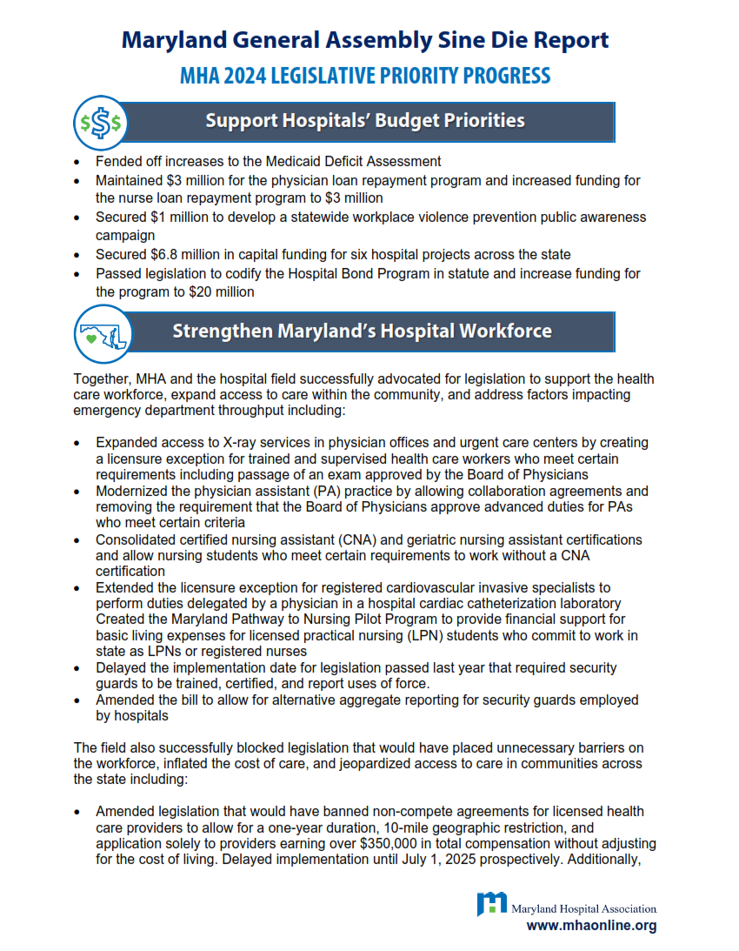
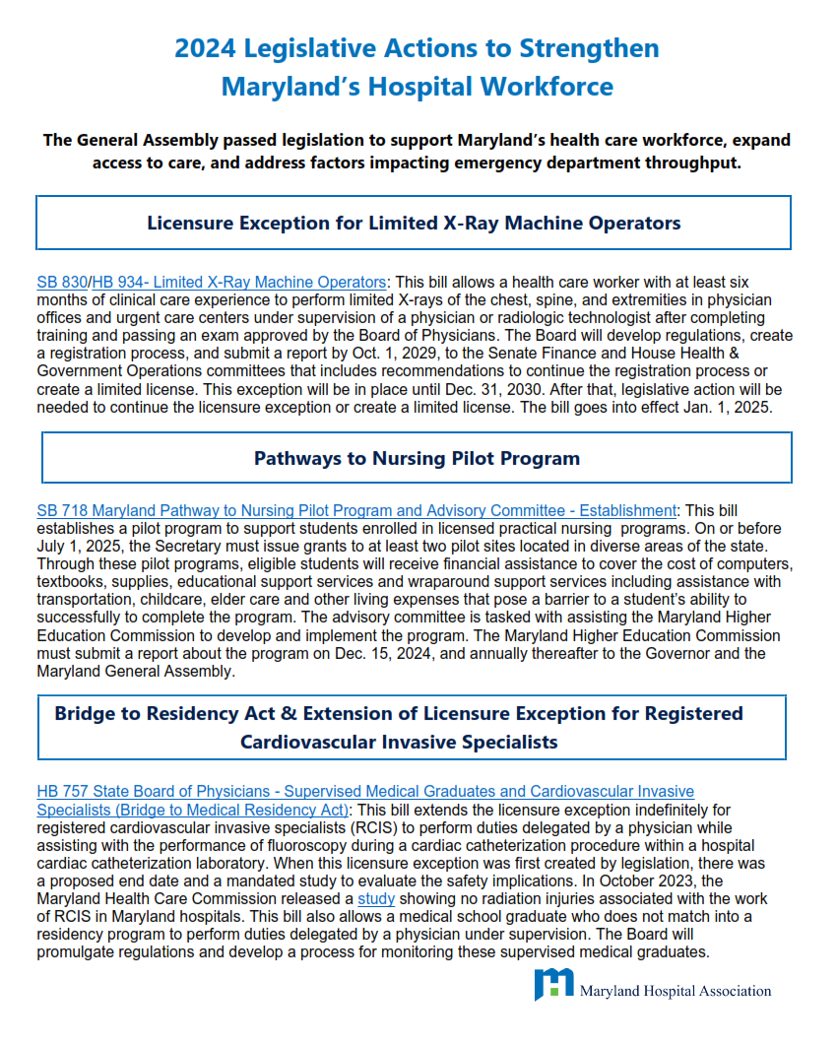
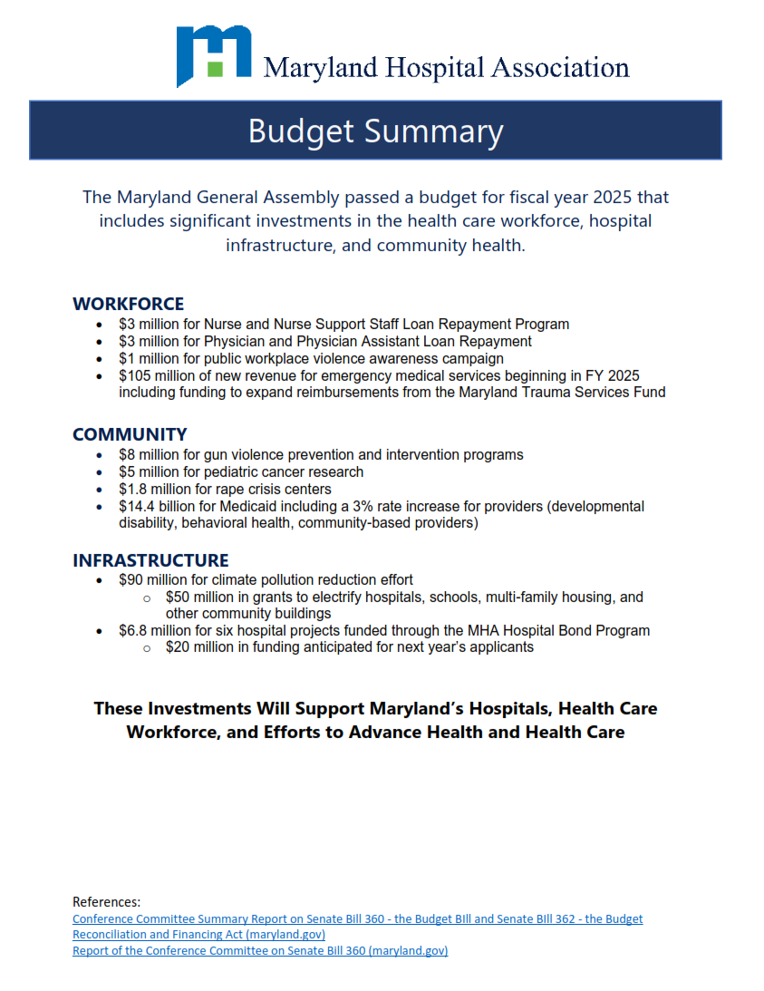
more MHA member resources
Sine Die Report
Post-Session Action Map
Bill Summary: Key Takeaways
Find Resources at: mhaonline.org/advocacy/state/members

