Slide 1
Hospital Throughput Workgroup
October 18, 2023

Slide 2
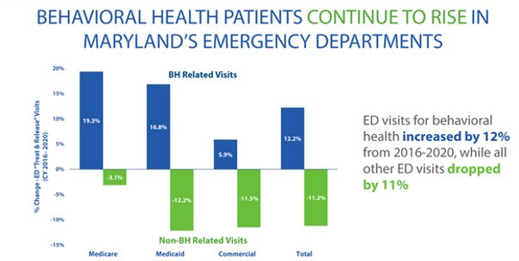
Behavioral Health ED Utilization

Slide 3
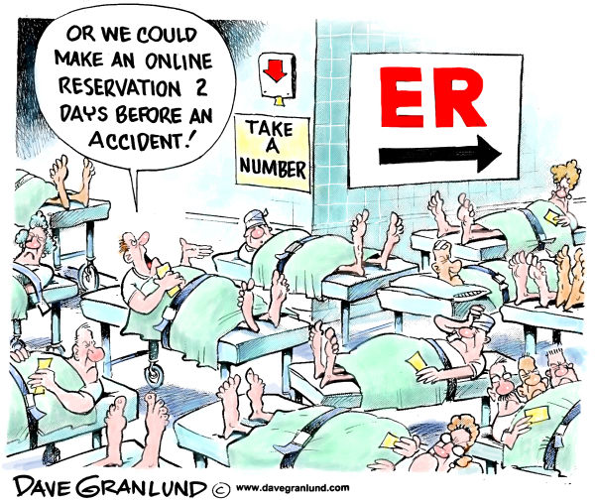
Emergency Department Patient Boarding 10 Day Analysis November 2021
Each Day at any given time, 200-350+ patients boarding in Maryland Eds
20-25% of ED patients either
Stuck without a disposition (e.g., psych 25%)
Holding for a disposition destination to become available (e.g., no room at the inn)
Snapshot
Medical patients: 7.4 hours
Psych: 33.7 hours
Psych = 25% boarders; 68% boarding time
Source: Maryland Health Care Commission, January 26, 2022

Slide 4
Children’s Services | Mental Health Capacity
Pre-pandemic, Maryland’s rate of private psychiatric inpatient utilization was 67% higher than the national average.
Since the pandemic, use of OP mental health services by Medicaid-insured children decreased by 10%, while use of specialty services [psych rehab, TCM, 1915(i)] for more acute needs decreased by 28%.
In FY2021, 100x more children used inpatient and RTC levels of care than were diverted from these levels of care with the 1915(i) program.
The reduced capacity in lower levels of care put upward pressure on the continuum of mental health services.
Source: SAMHSA, Mental Health: National Outcome Measures (NOMS): Maryland 2019; Dept. of Legislative Services, FY23 Budget Analysis, pp. 8-12.

Slide 5
Overview of CBH
89 provider organizations with a statewide reach
Primarily serve Medicaid, Medicare, duals
PBHS serves almost 300,000 kids and adults
Provide a full continuum of community-based MH and SUD services/supports including
Outpatient Clinics
Child & Adult Psychiatric Rehabilitation
Case Management
Residential Crisis Beds
Residential Rehab Programs & Supported Housing
Health Homes
Assertive Community Treatment (ACT)
Mobile Crisis
Targeted Case Management (TCM)
1915i
IOP
Residential SUD

Slide 6
Challenges
Historic underfunding / inadequate rates
Decades of cuts/lack of inflationary adjustments
Lower reimbursement by Medicare/commercial carriers
Minimum wage mandated rate increases end this FY.
Workforce
Was at a crisis level prior to the pandemic for both licensed and paraprofessional staff
From 2019 – 2021 Psychiatrist salaries have increased 34% and therapists 18%
Same time period rates increased 11%
Beds go unfilled due to lack of adequate staff coverage
Inflexible reimbursement that rewards volume, not results

Slide 7
Innovative Approaches
Implement Certified Community Behavioral Health Clinics (CCBHCs)
Based on FQHC model of comprehensive care but with a BH focus
CCBHCs must provide 9 required services, including 24/7 crisis intervention
CCBHCs receive cost-based reimbursement (with state approval)
Reported outcomes determined by the feds and the state
SB 362/HB 1148 – MDH to apply for planning grant in 2024; demonstration status in 2025

Slide 8
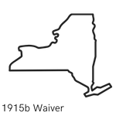
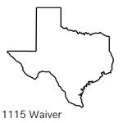
National Outcomes
New York
All-cause readmission dropped 55% after year 1
BH inpatient services show a 27% decrease in monthly cost
BH ED services show a 26% decrease in monthly cost
ED health services decreased 30% in monthly cost
21% increase in BH services for children and youth
Missouri
Hospitalizations dropped 20% after 3 years, ED visits dropped 36%
Overall access to BH services increased 23% in 3 years, with veteran services increasing 19%
Justice involvement with BH populations decreased 55% in 1 year
Texas
The CCBHC model in Texas is projected to save $10 billion by 2030
In 2 years, there were no waitlists at any CCBHC clinic
40% of clients treated for cooccurring SUD and MI needs, compared to 25% of other clinics

Slide 9
CCBHC Outcome Requirements
Clinic-Collected Measures (Required)
Time to Services (I-SERV)*
Depression Remission at Six Months (DEP-REM-6)*
Preventive Care and Screening: Unhealthy Alcohol Use: Screening and Brief Counseling (ASC)
Screening for Clinical Depression and Follow-Up Plan (CDF-CH and CDF-AD)
Screening for Social Drivers of Health (SDOH)*
State-Collected Measures (Required)
Patient Experience of Care Survey
Youth/Family Experience of Care Survey
Adherence to Antipsychotic Medications for Individuals with Schizophrenia (SAA-AD)
Follow-Up After Hospitalization for Mental Illness, ages 18+ (adult) (FUH-AD)
Follow-Up After Hospitalization for Mental Illness, ages 6 to 17 (child/adolescent) (FUH-CH)
Initiation and Engagement of Alcohol and Other Drug Dependence Treatment (IET-AD)
Follow-Up After Emergency Department Visit for Mental Illness (FUM-CH and FUM-AD)
Follow-Up After Emergency Department Visit for Alcohol and Other Drug Dependence (FUA-CH and FUA-AD)
Plan All-Cause Readmissions Rate (PCR-AD)
Follow-Up Care for Children Prescribed Attention-Deficit Hyperactivity Disorder (ADHD) Medication (ADD-CH)
Antidepressant Medication Management (AMM-BH)
Use of Pharmacotherapy for Opioid Use Disorder (OUD-AD)*
Hemoglobin A1c Control for Patients with Diabetes (HBD-AD)*
* new or adopted measure

Slide 10
Federal & State Actions Across the Country
Established the CCBHC Model through Medicaid Demonstration
CCBHC Planning Grant (2016)
CCBHC Planning Grant (2023)
No CCBHC Actions
State Legislation to Pursue the CCBHC Model
CCBHC Clinic-level SAMHSA Grant

Slide 11
Maryland Behavioral Health Solutions (MBHS)
29 of our most savvy organizations with a statewide reach
Operate under a single signature authority
Automated data exchange with CRISP with demonstrated improvement in timely follow-ups after hospital discharges
Automated feed from participating providers’ EHRs into shared warehouse
Utilize evidence-based and best practices and technology solutions
Use population management and intensive care management

Slide 12
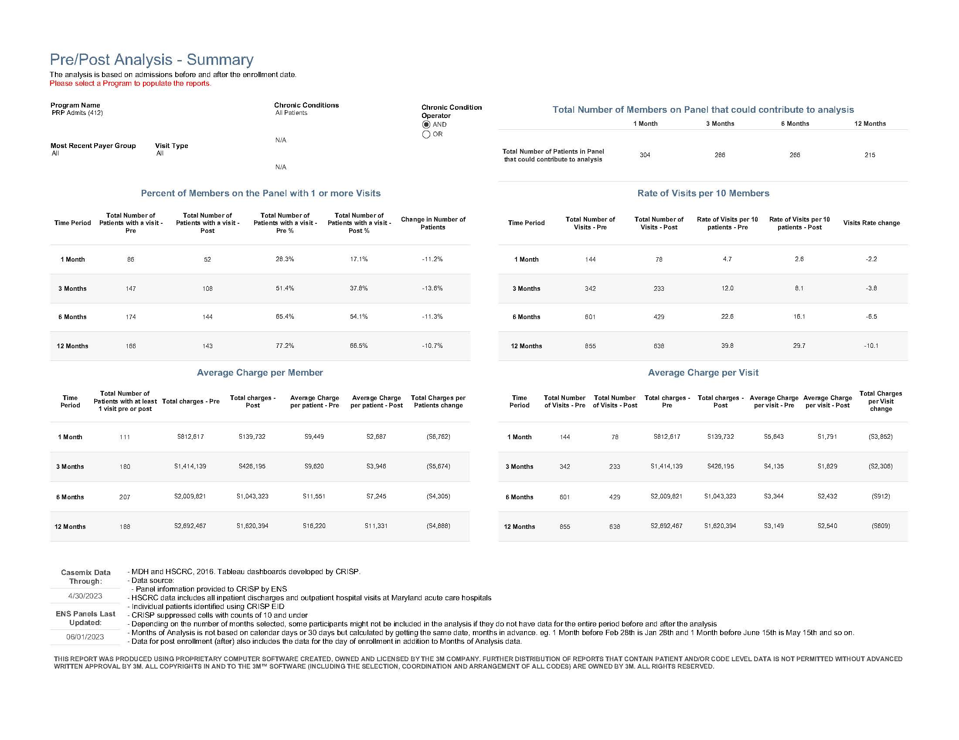

Slide 13
MBHS Provider Network Outcomes
CRISP Pre/Post analysis of 304 individuals with SMI
Based on claims data
Compared costs pre/post at 1, 3, 6, and 12 months
Reduction in Total Charges:
1 month = $672.89
3 months = $987.94
6 months = $966.50
12 months = $1,072.08
The majority of the savings were attributed to reduced ED utilization and shorter IP LOS
Psych readmission rate of 2% for 728 individuals with SMI (CY22)
High risk of suicidality (1,232) in May; 986 moved to low risk by June – 30% improvement in the rate of remission compared to project launch 2 years ago.

Slide 14
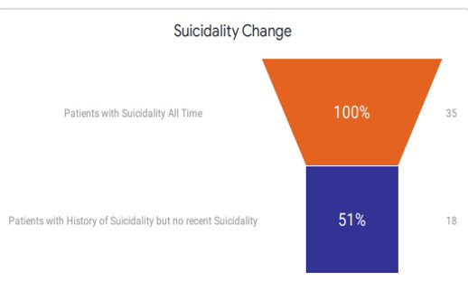
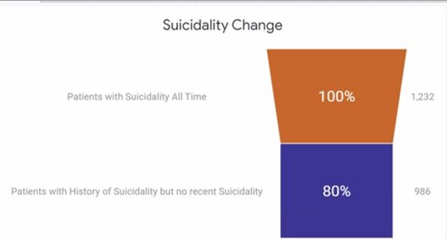
Analytics and collective focus can yield results​
30-day remission of new patients flagging high-risk for suicide at intake
2021 at launch​
2023 after two years​

Slide 15
Suggested Actions
Support implementation of CCBHCs
Create a rate setting process that covers the cost of providing services and allows for reinvestment in staff and other improvements
Delegating nurses to oversee medical needs
Investment in EHRs, other technology
Create a value-based payment approach that rewards results rather than volume (process and/or product outcomes)
Rebalance C&A services from a focus on more hospital beds/RTCs to support for TCM, 1915(i) wraparound that averts higher LOC
Support funding for intensive care management services

Slide 16
For further information
Email – Lori@mdcbh.org
Cell - 410-456-1127

