Slide 1
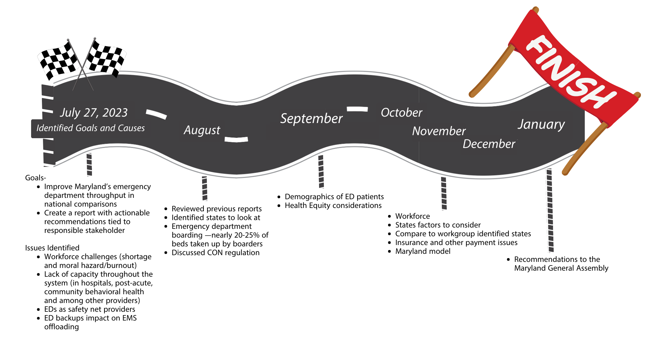
General Assembly Hospital Throughput Work Group: The Road Ahead

