Slide 1
Hospital and Regional Factors Associated with
ED Length of Stay
Geoff Dougherty, PhD, MPH
Deputy Director, Population Health

Slide 2
Motivating Questions for Today’s Presentation
How does Maryland performance on ED Length of Stay (LOS) compare to nation prior to and during the TCOC Model?
What is the relative contribution of regional and hospital-specific determinants of ED Length of Stay on a national level?
What kinds of improvements in ED Length of Stay can we expect from specific interventions on these determinants?
What policies/programs are suggested by these analytic results?

Slide 3
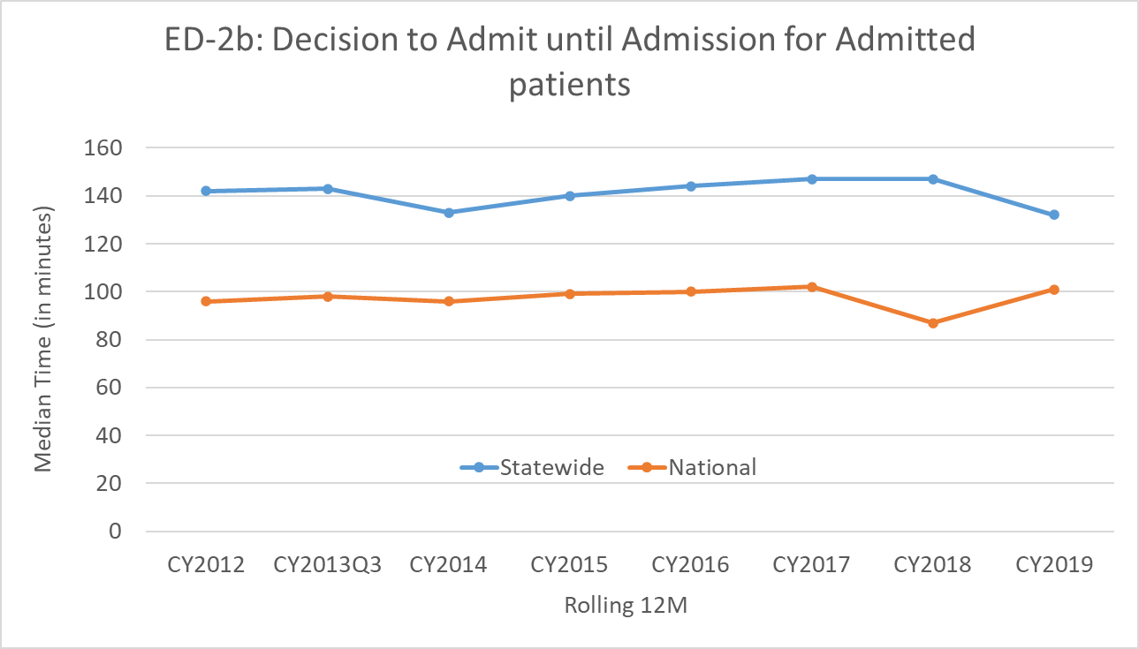
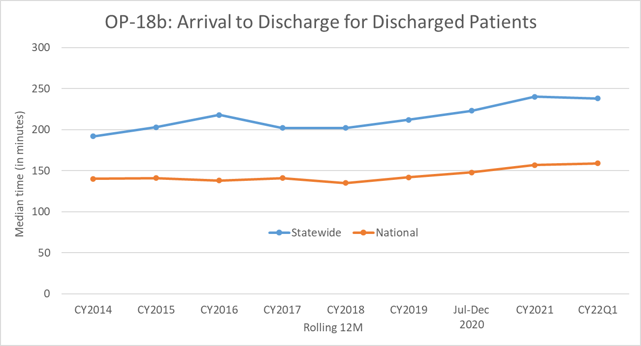
What is the Extent of the ED Length of Stay Problem?
Maryland’s performance has been poor since measures were first publicly reported in CY 2012 (CY 2014 for OP-18b)
Performance gap has remained relatively unchanged

Slide 4
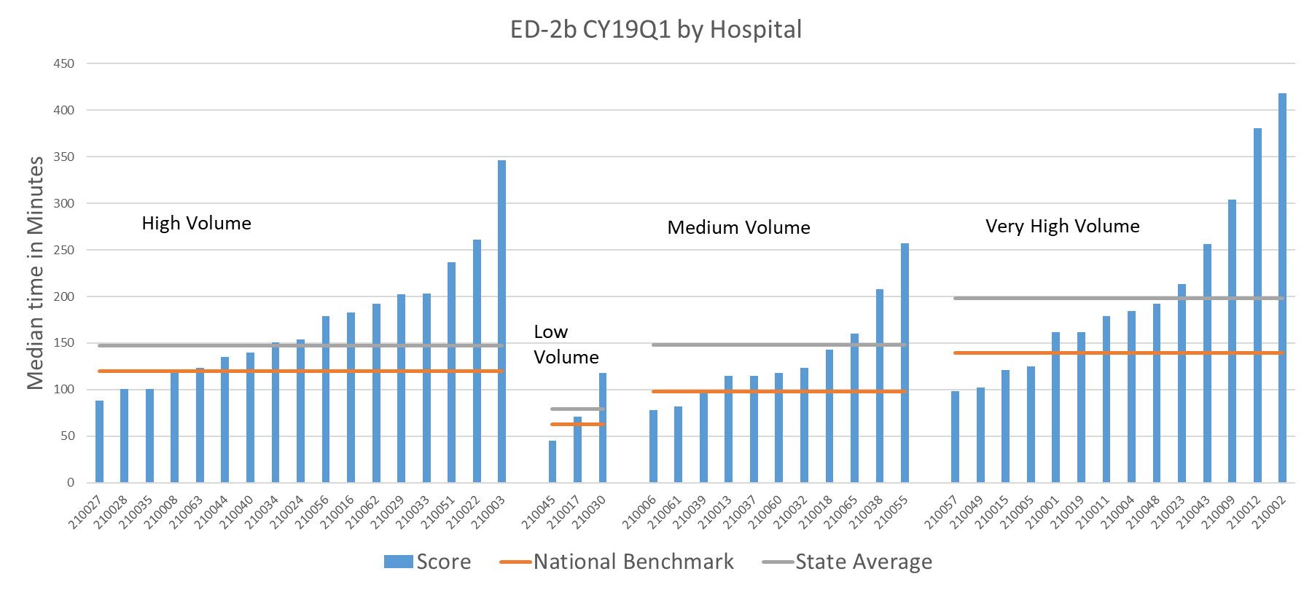
Are ED Length of Stay Issues Widespread?
CMS stratified hospitals into volume categories to account for different expected levels of performance; Maryland tends to have higher volume hospitals (more on that later)
With the exception of low volume hospitals (0-19,999 ED visits), the vast majority of Maryland hospitals exceed the national median for their volume category

Slide 5
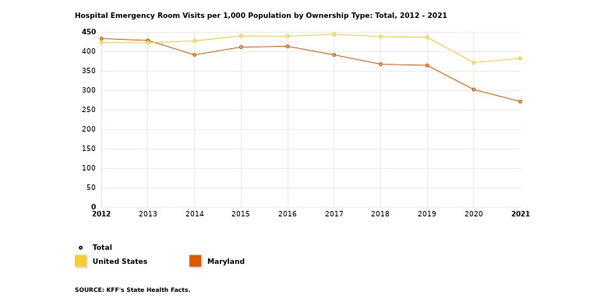
How Does Our ED Volume Compare to US?
Maryland has reduced ED visits per capita well below national average, likely due to:
Care management investments
Primary care investments
New site alternatives (e.g., urgent care)
Similar findings were outlined in the evaluation of the TCOC Model
“The Maryland Model reduced [Medicare FFS] outpatient ED visits and observations stays by an average of 16 visits per 1,000 beneficiaries (90% CI -25, -8; 3.8 percent) in the first three years of the MD TCOC period” (Page 13)
https://www.kff.org/other/state-indicator/emergency-room-visits-by-ownership/ (only includes community hospitals)
https://www.mathematica.org/publications/evaluation-of-the-maryland-total-cost-of-care-model-quantitative-only-report-for-the-models-first

Slide 6
Intermediate Conclusions
There is a meaningful decline in ED Visits in Maryland ED over the last decade
Despite reductions in ED visits, which should have depressurized emergency rooms, ED Length of Stay is still high
Other factors may be driving high ED Length of Stay and by extension lower patient satisfaction

Slide 7
Statistical Modeling Approach
We modeled
Hospital Referral Region (N=306)
Individual Hospital (N=3019)
The model assesses the degree to which each determinant is associated with added ED Length of Stay
e.g.,: “A change of one year in median population age is associated with an increase of 10 minutes ED Length of Stay”
The model also provides guidance on what proportion of variation in ED Length of Stay is driven by HRR and hospital-specific factors
Finally, we evaluated factors underlying one particular determinant of ED Length of Stay: inpatient occupancy rate

Slide 8
Data Sources
Hospital Referral Region
US Census: Population size, age, density
CDC: Social Vulnerability Index
AHA Survey: IP Beds per capita
CMS: PCPs and SNFS per capita
Dartmouth Atlas: Primary care access and surgical volume for Medicare population
2019 AHA Survey: ED visits, IP visits, services provided, teaching status, hospital staffing, IP occupancy
CMS Hospital Compare
2019 ED1 and OP18

Slide 9
Additional Details
Presentation focuses on ED1, but takeaways for OP18 and composite measure are similar
Data that would have been helpful but weren’t obtainable
ED-specific hospital staffing and resources (AHA mostly provides hospital-wide numbers)
Patient acuity
Because of data limitations and policy interest, this work focuses on impact of factors related to ED inflow and output, rather than movement of patients within the ED
Our model does not account for interactions and non-linear relationships. More on this later
Data are mostly self-reported and cross-sectional

Slide 10
Summary of Analytic Findings
Differences between Hospital Referral Regions account for 37% of variation in Median Time from ED Arrival to ED Departure for Admitted ED Patients (ED1b)
Differences between hospitals within Hospital Referral Regions account for 63% variation in ED1b performance
This indicates that hospital factors (e.g. staffing, bed management, organizational structure) are likely driving ED performance
HRR/regional factors (IP Beds per capita, SNF beds) are less important
Primary care access is an important and modifiable determinant of ED length of stay
Addressing social determinants may also improve ED length of stay performance
Structural hospital factors (Bed size, complexity, teaching status, ED size) that are not as easily modifiable have a large effect on ED performance)

Slide 11
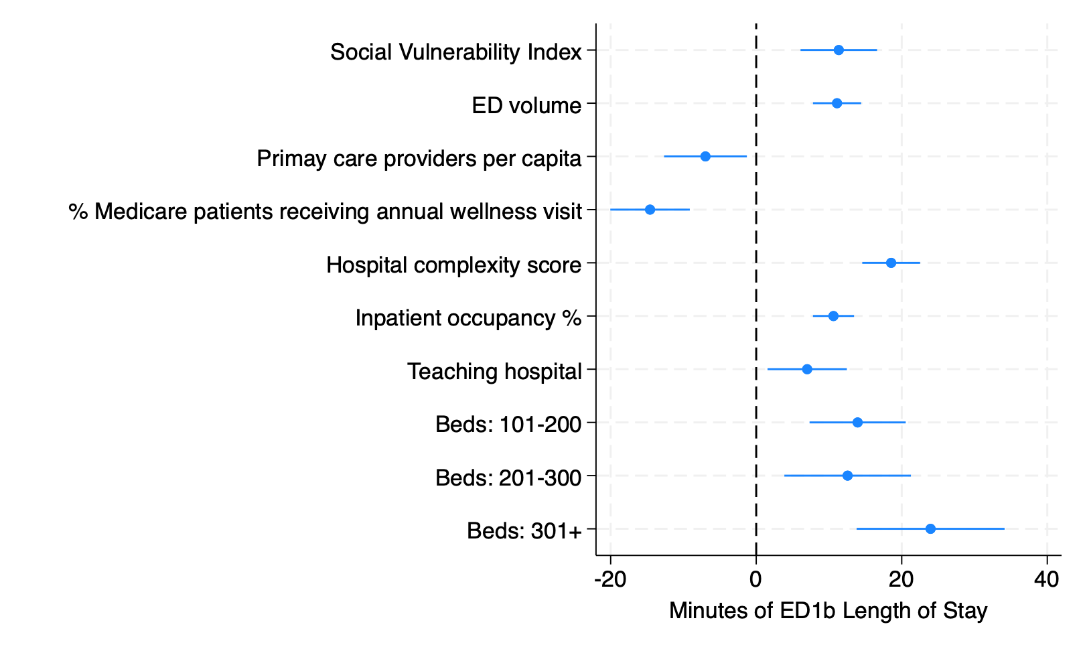
Relative Strength of Association with ED Length of Stay
Comparative ED Length of Stay effect size of all statistically significant variables in national model
Model accounts for 67% of variation in ED1b performance across hospitals

Slide 12
Performance of MD Hospitals vs. Nation
Maryland hospitals are larger,more complex, and more likely to be teaching facilities. All of these factors are associated with longer ED Length of Stay
This is a blessing and a curse. Larger, higher-volume and more complex hospitals typically provide better outcomes in terms of risk-adjusted mortality, readmission and inpatient length of stay
After accounting for structural differences, Maryland hospitals are not doing as poorly as reported
However, some big, complicated hospitals nationally still perform well in ED Length of Stay (See Appendix B), so Maryland has significant room for improvement
Can we provide both excellent IP results and better streamlined ED experience by finding ways to make big hospitals feel more like small ones (or high performing hospitals elsewhere in the nation that are big and complicated)?

Slide 13
What About Occupancy?
Hospital occupancy is an important determinant of ED Length of Stay, and a complex topic in its own right
We evaluated the independent association of multiple variables with inpatient occupancy
IP beds per capita
Length of Stay
End of Life Care
SNF beds per capita
Surgical volume
Occupancy = AHA IP bed days / (365* IP beds staffed EOY)

Slide 14
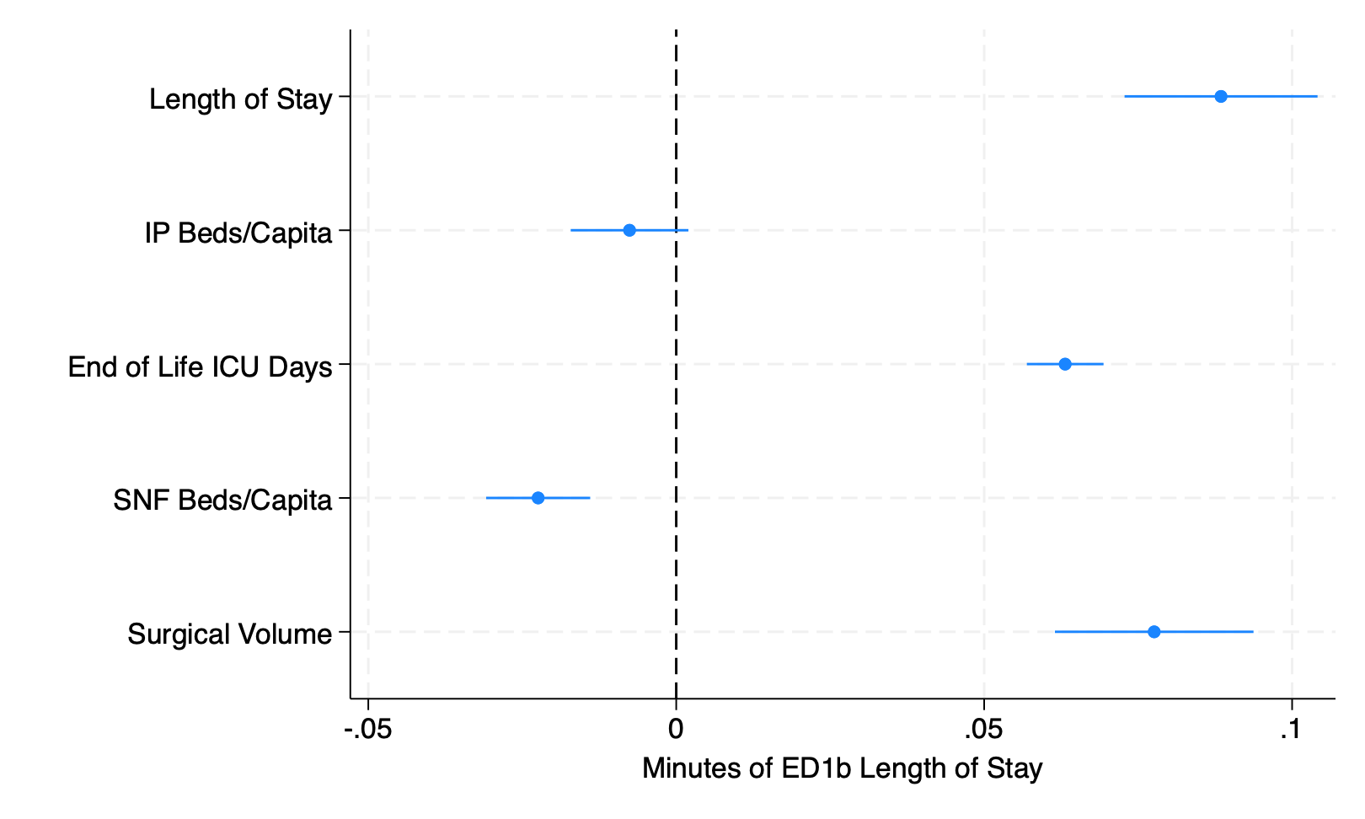
Relative Strength of Association with IP Occupancy
Surgical volume, LOS, end of life ICU days, and SNF availability are significant determinants of occupancy
MD differs from the nation unfavorably on all measures
IP beds per capita has a smaller association that did not rise to statistical significance
MD beds per capita (exclusive of beds in nearby regions, e.g., DC) are lower than national average due to reduced demand under TCOC model

Slide 15
What Does Analysis Tell Us About Policy/Program Directions?
Policies addressing primary care may result in improved ED Length of Stay
Reimbursement Enhancements: Maryland Primary Care Program (MDPCP)
Investments in additional primary care supply
Policies addressing social determinants may also result in improved ED Length of Stay
Policies addressing IP occupancy may result in improved ED Length of Stay
Improved hospice access
Improved SNF access
Planning elective surgery and medical admissions to avoid constraining ED admissions
Increasing inpatient bed capacity is not likely to be a viable and sustainable solution to ED Length of Stay in Maryland
Stacking more beds in institutions that have structural impediments to low ED throughput may worsen the problem
Expanding IP capacity would likely be a costly, long-range solution that has negative implications for TCOC model performance
Other interventions discussed above may provide similar or better outcomes with limited cost and downside

Slide 16
Testing Interventions

Slide 17
Developing a Testing Platform
Because conventional statistical modeling (i.e., regression) does not account for nonlinearities, bidirectional causation, etc., it does not always provide a clear picture of the impact of future interventions
Simulation exercises are a standard way to address this blind spot
If SimCity had an emergency room …
Long history of this type of work in operations science and hospital performance literature
Most straightforward modeling approach divides hospital areas of interest into buckets or “stocks”, and moves patients between them with flow rates

Slide 18
Simulation Process Overview
Identify the setting for the model’s base case
Identify variables that are to be reflected in model
Obtain real-world values for these variables
Build the base case model using Models are be populated with real-world data and tested to ensure they reproduce real-world conditions prior to testing hypotheses

Slide 19
Our Model
Hospital: Suburban Baltimore community hospital with ED LOS, bed count and ED volume close to the state average in 2019
Key stocks
Patients being treated in ED
Patients admitted and awaiting a bed
Patients on inpatient service, patients awaiting direct/elective admission
Key flows
ED visit volume
Admission rate from ED and direct admit
IP discharge rate (linked to LOS)
System Dynamics
Bottlenecks
Thresholds
See Lane et al. (2000) ‘Looking in the wrong place for healthcare improvements: A system dynamics study of an accident and emergency department’, The Journal of the Operational Research Society.

Slide 20
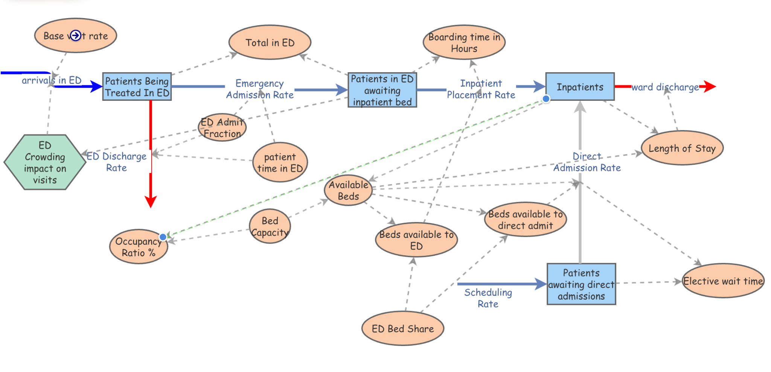
Baseline Model
ED Visits: 131/Day
Admitted: 18%
Boarding Time: 2.5 hours
ED Treatment Time: 5 hours
Med/Surg Beds: 178
Occupancy: 95%
LOS: 5.3 days
Source: HSCRC casemix, CMS Hospital Compare

Slide 21
Interventions Tested
Reduce ED volume by 5%, reflecting modest cut in volume from multi-visit patients (more on this later)
Reduce LOS by 5%, reflecting modest increase in SNF/behavioral beds
Reduce daily elective/direct admit volume by 1 patient/day
How to measure impact of interventions?
Boarding time
Elective admit wait time
Total # of patients in ED
How to interpret results?
Model provides evidence of plausible effect of system changes
Best viewed as qualitative/directional, rather than as precise estimates

Slide 22
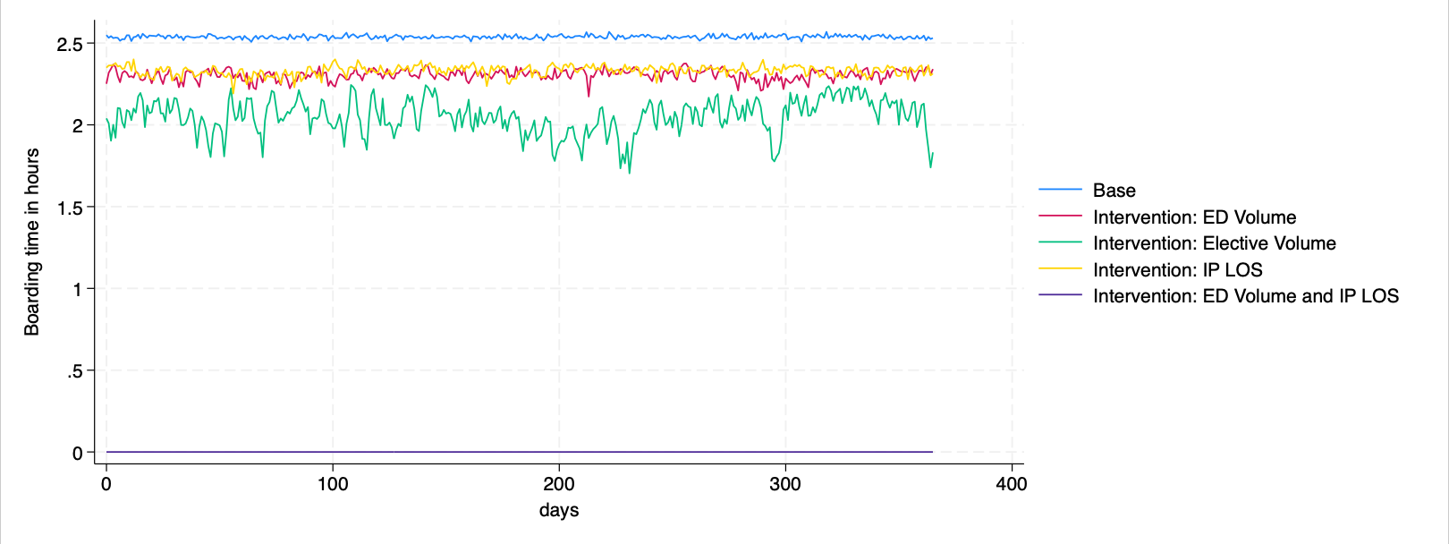
Small Interventions Yielded Large Improvements in Performance
Base case boarding time is ~2.5 hours. Small changes in ED volume, elective volume and LOS result in modest improvement. Combined intervention eliminates boarding time.

Slide 23
Key takeaways
Findings are consistent with our understanding of complex systems - chaotic systems can be tamed with seemingly small, but carefully selected changes
By contrast, other changes, such as reducing patient treatment times in ED, may have unexpected consequences
Interventions that are cheaper and/or quicker than adding physical beds may significantly improve patient experience and outcomes
There are a wide variety of programs and policies that could achieve results similar to those shown here
Simulation results are consistent with those from regression models
Hospital-level interventions can be effective
Reducing IP occupancy through better SNF/behavioral/hospice access and reducing ED volume through hospice and care management are important areas for further exploration

Slide 24
Caveats
There are likely many ways to build a model that uses real-world data and reproduces conditions on the ground
There’s no guarantee that our interventions, tested within a different but equally plausible model, would yield the same results
However, our results are consistent with those from regression modeling, and also with principles developed over decades of research into complex systems theory
The model does not address some important dynamics
Hour-by-hour fluctuation in ED arrival and IP departure volume
Specific actions to reduce LOS or ED volume

Slide 25
HSCRC Opportunities

Slide 26
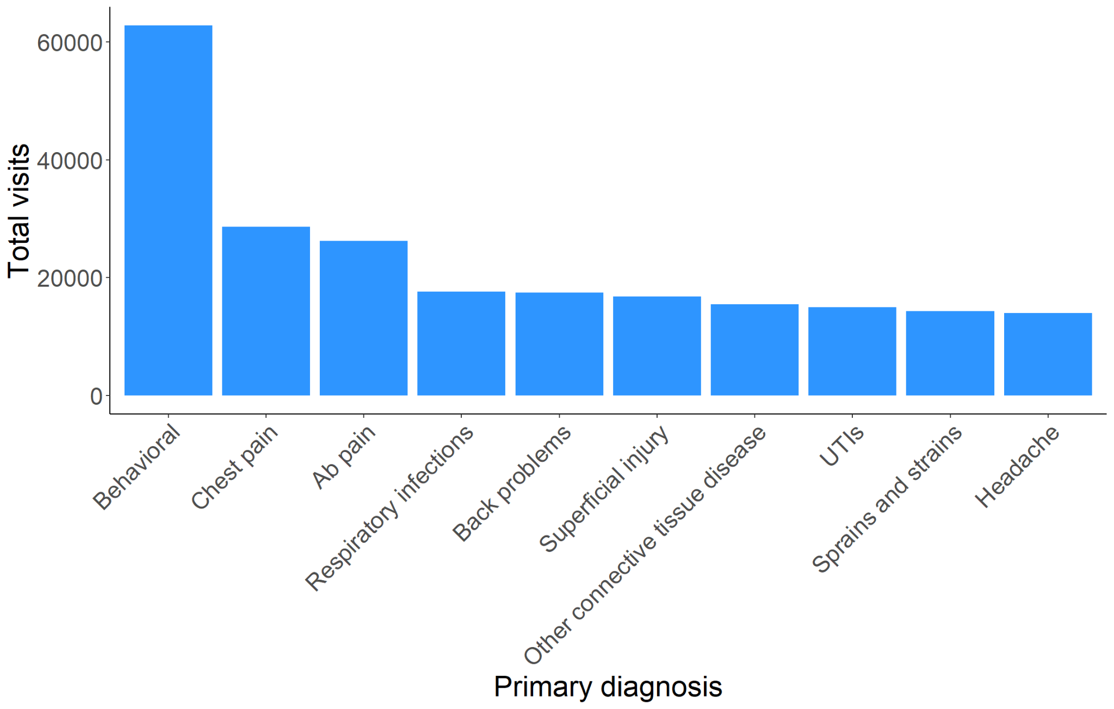
The Multi-Visit Patient Opportunity
MVP: Patient w/ >=4 ED visits in year
Accounted for 29% of 2019 ED visits
18% were admitted
Of outpatient visits by MVPs, 62% are for low-acuity principal diagnoses
Wide variation in MVP ED visit and admission rates between hospitals

Slide 27
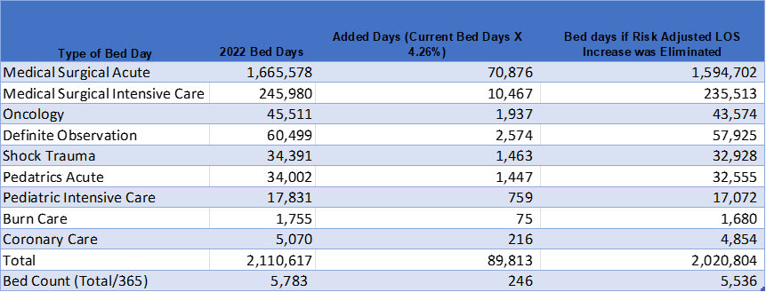
IP LOS Opportunity
IP LOS has increased since the confounding effects of the COVID-19 pandemic
However, after accounting for acuity change and mix change (e.g., shift of surgeries to Outpatient and Ambulatory Surgery Centers), there still appears to be a statewide IP LOS increase of 4.26% from 2019 to 2022
Unadjusted LOS increased by ~16%
Variance of 4.26% between risk and mix adjusted LOS statistics suggests operational inefficiency opportunity
If investments were made to make Maryland’s risk adjusted LOS equivalent to 2019 experience, staffed bed capacity would increase by 246 beds
Would effectively add a new hospital; Average licensed bed size is 220 in FY 2024

Slide 28
Policy Recommendations
Recommendations for ongoing measurement and engagement
EDDIE - Continue to steward rapid cycle improvement in ED performance
Other Efforts Coordinated with Maryland Hospital Association
Recommendations for payment policy
Quality-Based Reimbursement (QBR) policy – Staff proposal provides new incentive for improvement on CMS ED-1 measure
Multi-Visit Patient policy – Financial reward for reduction in percentage of ED visits accounted for by patients with 4 or more visits per year
Workgroup to monitor impact of policies on ED performance, propose payment policy changes and provide periodic reporting to General Assembly

Slide 29
Appendix

Slide 30
Appendix A: Technical Details
End of life care is measured as number of ICU days during the last six months of life for each hospital referral area. The measure is compiled by the Dartmouth Atlas from Medicare claims data.
Institutional complexity is measured by summing the number of clinical services offered at a hospital, as recorded in the AHA survey. Services include obstetrics, cardiac intensive care, burn care, alcoholism/chemical dependency services, bariatric services, and dozens of others.
Surgical intensity is measured as the number of inpatient surgical procedures divided by the total number of hospital beds set up and staffed at year end.
Teaching status is assessed using AHA survey data. A hospital is deemed to be teaching institution if it is a participating site in one or more Accreditation Council for Graduate Medical Education accredited programs, reports a medical school affiliation to American Medical Association, or is a member of the Council of Teaching Hospital of the Association of American Medical Colleges.
Urban HRRs are those with a population density of greater than 1,000 people per square mile. Suburban HRRs are those with 500-999 persons per square mile. Rural HRRs are those with <500 persons per square mile.

Slide 31
Appendix B: Large, Complex Teaching Hospitals with Low ED LOS
Hospital | Location | Beds | ED1b (US Mean=270)
Fountain Valley Regional Hospital | Fountain Valley CA | 380 | 238
Morton Plant Hospital | Clearwater FL | 650 | 238
St. Joseph's Hospital | Tampa FL | 1062 | 240
Bayfront Health St. Petersburg | Saint Petersburg FL | 480 | 258
Northwestern Central DuPage Hospital | Winfield IL | 419 | 262
Palos Health | Palos Heights IL | 362 | 246
NorthShore University Health System | Evanston IL | 673 | 253
Southcoast Hospitals Group | Fall River MA | 497 | 264
DMC Harper University Hospital | Detroit MI | 394 | 266
Inova Alexandria Hospital | Alexandria VA | 302 | 248

Slide 32
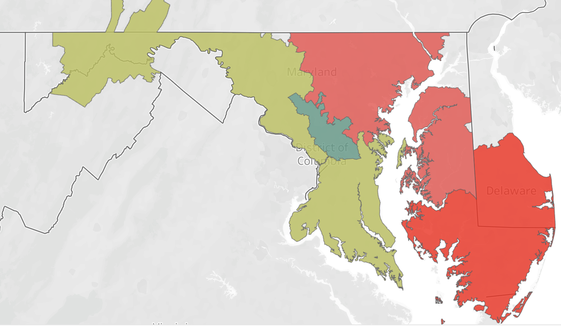
Appendix C: Maryland Hospital Referral Regions

